Slide 1



MLOps (Applied Track) & Git Github
Dr. Nilay Karade
Academic Program Manager

Slide 2
Agenda
MLOps lesson plan
Git & Github setup
https://git-scm.com/book/en/v2/Getting-Started-Installing-Git or https://phoenixnap.com/kb/how-to-install-git-windows
github.com
Git commands

Slide 3
Agenda
Git commands
config
init
status
add
commit
log
diff
rm
gitignore
branch
checkout
merge
remote
push
pull

Slide 4
MLOps (Machine Learning Operations)
Definition: MLOps is a set of practices and tools that combine machine learning (ML) system development and machine learning system operations (DevOps). It aims to streamline and automate the entire ML lifecycle, including model development, testing, deployment, monitoring, and maintenance.
Key Components:
Version Control: Git and GitHub
Containerization: Docker
Model Registry: MLFlow
AutoML: Pycaret
Benefits: MLOps improves collaboration, reproducibility, and reliability in ML projects, accelerating the development and deployment of models in production.

Slide 5

Git
Git is a distributed version control system (DVCS) designed to track changes in source code during software development. It allows multiple developers to collaborate on projects simultaneously.
Here's how it works:
Repository: Git operates within a repository, which is like a project folder that contains all the files and directories associated with your project. Each repository has its own history of changes.

Slide 6


Git
Commits: Git records changes to files in the repository through commits. A commit represents a snapshot of the project at a specific point in time. It includes the changes made to files since the last commit, along with a message describing the changes.

Slide 7
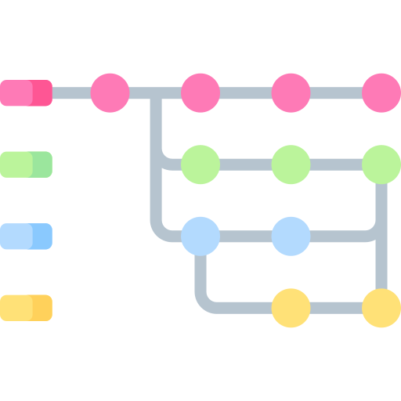
Git
Branches: Git allows for branching, which is like creating a parallel version of the project. Branches enable developers to work on new features or fixes without affecting the main project until they are ready. Once the changes are complete, they can be merged back into the main branch.

Slide 8
Git
Remote Repositories: Git supports remote repositories, which are copies of the repository hosted on a remote server (e.g., GitHub, GitLab). Remote repositories enable collaboration between developers by allowing them to push changes to a shared repository and pull changes made by others.

Slide 9
Git
Version History: Git maintains a complete history of changes made to the project, including who made the changes, when they were made, and the commit message associated with each change. This allows developers to track the evolution of the project over time and revert to previous versions if needed.

Slide 10
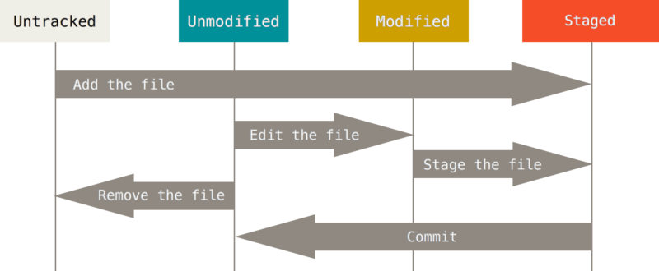
Recording Changes to the Repository
SOURCE: https://git-scm.com/book/en/v2/Git-Basics-Recording-Changes-to-the-Repository

Slide 11
config
git config is used to configure Git settings, such as user name and email.
Example:
git config --global user.name "Your Name"
git config --global user.email "youremail@example.com"

Slide 12
init
git init initializes a new Git repository in the current directory.
Example:
git init

Slide 13
status
git status shows the current state of your working directory and staging area. It displays files that are modified, untracked, or staged.
Example:
git status

Slide 14
add
git add stages changes, preparing them for the next commit.
Example:
git add filename.txt
git add --all
git add -A

Slide 15
commit
git commit records staged changes as a new commit in the Git history.
Example:
git commit -m "Add new feature“
git add -A && git commit -m "Your Message"

Slide 16
Assignment - Git
Create new project folder and apply following git commands
Create a file
Initialize git
Check the status of a file
Add file to staging area
Check status of a file
Modify file content
Check status of a file
Add file to staged area
Apply commit with message

Slide 17
Jamboard activity
https://jamboard.google.com/d/1HBB5NYy8-sbC8NAtdmd8d3OLo1fMkE1K1HfpUSiuL58/edit?usp=sharing

Slide 18
log
git log displays a history of commits in the repository, including commit messages, authors, and commit IDs.
Example:
git log
Parameters:
-<n>, --max-count=<n>: Limits the number of commits displayed to <n>.
--since=<date>: Shows commits more recent than a specific date.
--until=<date>: Shows commits older than a specific date.
--author=<pattern>: Shows commits made by authors matching the specified pattern.
--grep=<pattern>: Shows commits with commit messages that match the specified pattern.
--graph: Displays the commit history as a text-based graph, showing the branching and merging of commits.
--stat: Displays summary statistics for each commit, showing the number of files changed and the number of lines added or removed.

Slide 19
diff
When you run git diff without any arguments, Git will show you the differences between the changes in your working directory and the staging area. This includes changes that have been made but not yet staged for commit.
Example:
git diff
You can also specify files or directories as arguments to git diff to compare changes between different commits, branches, or specific files. For example:
git diff <commit>: Shows the differences between the working directory and the specified commit.
git diff <commit> <file>: Shows the differences between the specified commit and the version of the file in the working directory.

Slide 20
rm
The git rm command is used to remove files from your Git repository. It's similar to the rm command in Unix-like operating systems, but it also stages the removal of the file in Git's staging area.
To remove a file from both your working directory and the staging area:
git rm <file>
This command removes the specified file from your working directory and stages the removal. It will also be removed from future commits.
To remove multiple files:
git rm <file1> <file2> <file3> ...
You can specify multiple files to be removed in a single command.
To remove files while keeping them in your working directory:
git rm --cached <file>
This command removes the specified file from the staging area but leaves it in your working directory. It means the file will be untracked by Git, but it won't be deleted from your file system.
To remove a directory:
git rm -r <directory>
This command recursively removes all files and directories within the specified directory.

Slide 21
Assignment - Git
Explore following commands with atleast 2 parameters
log
diff
rm

Slide 22
.gitignore
.gitignore is a file where you specify files or directories that should be ignored by Git (e.g., temporary files, logs).
Example: Create a .gitignore file with contents like:
data.csv
Copy code
*.txt
Json_data/

Slide 23
branch
git branch lists all branches in the repository, showing the current branch with an asterisk.
Example:
git branch

Slide 24
checkout
git checkout switches to a different branch or commit. It's used for branch management and code navigation.
Example:
git checkout new-feature-branch

Slide 25
checkout
The git checkout command in Git is a versatile command used for various purposes, depending on the arguments provided. Here are some common use cases:
Switch Branches: If you want to switch to a different branch, you use git checkout followed by the name of the branch you want to switch to. For example:
git checkout <branch_name>
Create a New Branch: You can also use git checkout to create and switch to a new branch in one step. For example:
git checkout -b <new_branch_name>
This creates a new branch with the specified name and switches to it.

Slide 26
merge
git merge combines changes from one branch into another. It's used to integrate feature branches into the main branch.
Example:
git merge feature-branch

Slide 27
checkout
Discard Changes in a File: If you've made changes to a file in your working directory and want to discard those changes and revert the file to its state in the last commit, you can use git checkout followed by the file name. For example:
git checkout <file_name>
Discard All Changes: To discard all changes in your working directory and revert it to the state of the last commit, you can use git checkout with a dot (.) as the argument. For example:
git checkout .
Checkout Specific Commit: You can also checkout a specific commit by providing its hash or identifier. For example:
git checkout <commit_hash>

Slide 28
remote
The git remote add origin command is used to add a remote repository URL to your local Git repository. This command establishes a connection between your local repository and a remote repository hosted on a server, such as GitHub
Example:
git remote add origin https://github.com/nilaykarade/test2.git

Slide 29
push
git push sends your local commits to a remote repository, typically on a service like GitHub or GitLab.
Example:
git push origin main

Slide 30
Summary
Git & Github setup
Git commands
config
init
status
add
commit
log
diff
rm
gitignore
branch
checkout
merge
remote
push

